Slide 1
COMP 4332 / RMBI 4310 Big Data Mining (Spring 2020)
Tutorial 8 Neural CF, Wide & Deep Learning
TA: Haoran Li (hlibt@connect.ust.hk)

Slide 2
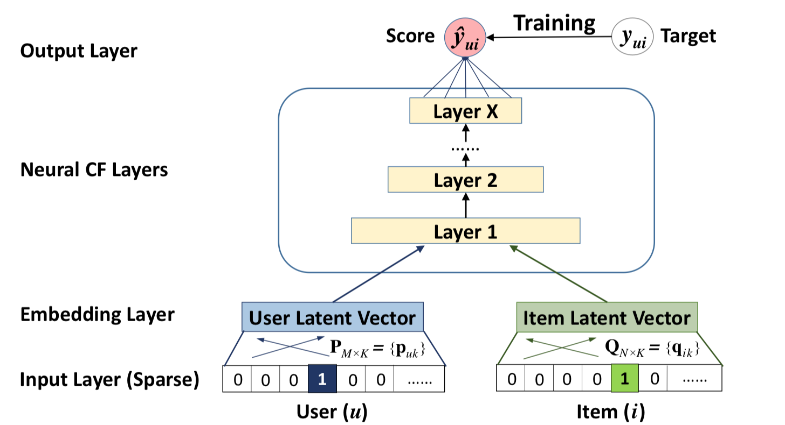
Neural CF
Xiangnan He, Lizi Liao, Hanwang Zhang, Liqiang Nie, Xia Hu and Tat-Seng Chua (2017). Neural Collaborative Filtering. In Proceedings of WWW '17, Perth, Australia, April 03-07, 2017.

Slide 3
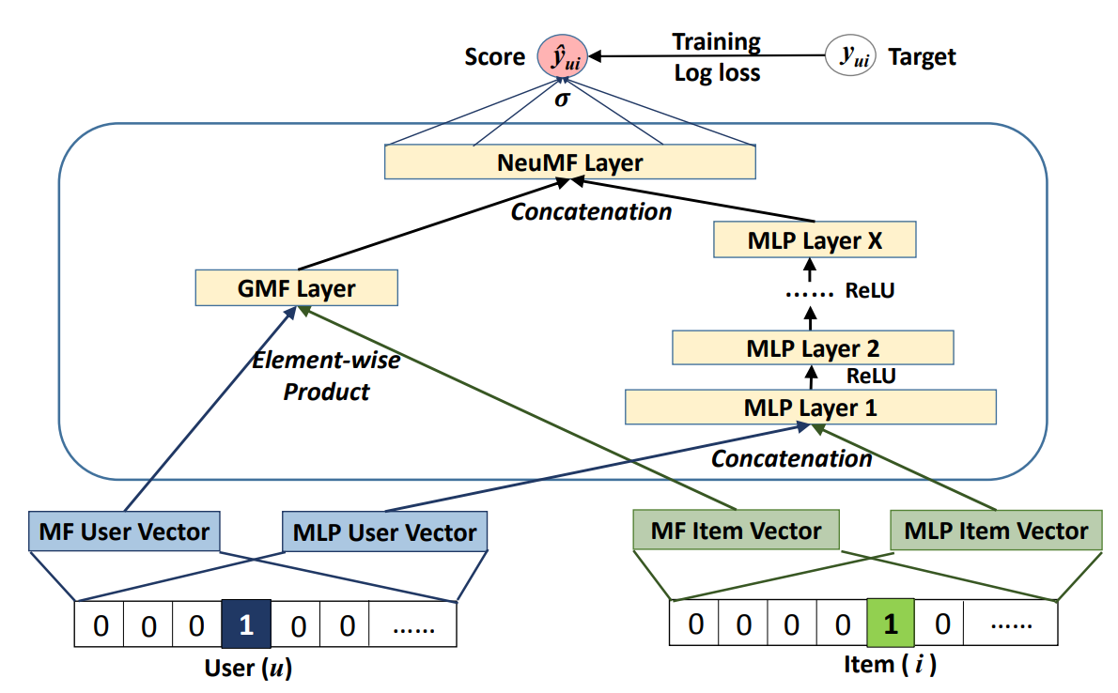
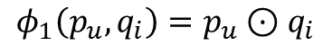
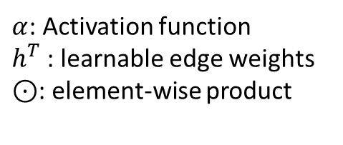
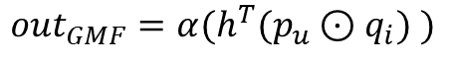
Generalized Matrix Factorization
$$out_{GMF}=α(h^{T}(p_{u}⊙q_{i}) )$$
$$φ_{1}\left(p_{u},q_{i}\right)=p_{u}⊙q_{i}$$
$α$: Activation function
$h^{T}$: learnable edge weights
$⊙$: element-wise product

Slide 4
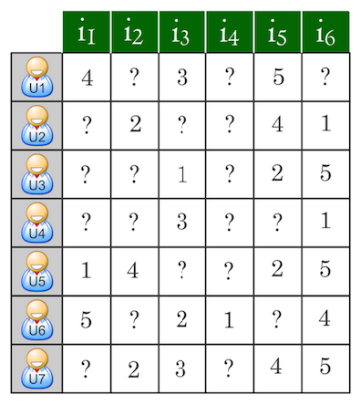
Rating Prediction
Predict users’ ratings on items given some known ratings. The prediction would be evaluated by Root Mean Squared Error (RMSE)

Slide 5
Implementation of the Rating Prediction Task
See the jupyter-notebook.

Slide 6
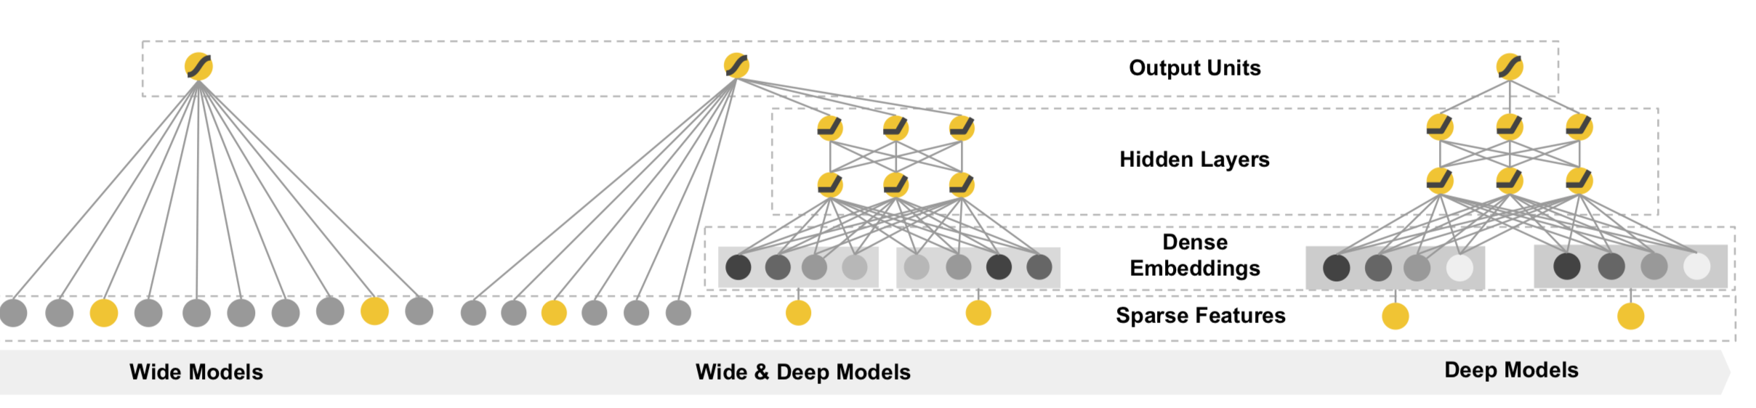
Wide & Deep Learning
Memorization
Generalization
Heng-Tze Cheng,Levent Koc,Jeremiah Harmsen,Tal Shaked,Tushar Chandra, Hrishi Aradhye, Glen Anderson, Greg Corrado, Wei Chai, Mustafa Ispir, et al. 2016. Wide & deep learning for recommender systems. In Proceedings of the 1st Workshop on Deep Learning for Recommender Systems. ACM, 7–10.

Slide 7
The wide model
Memorization
Exploiting the correlation available in the historical data

Slide 8
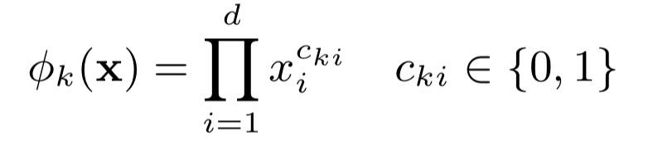
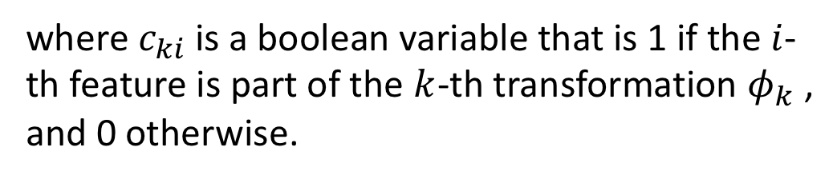
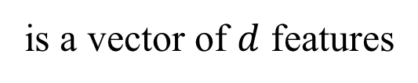
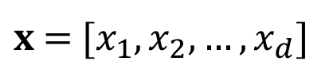
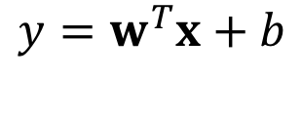
The wide model
Linear model:
$$y=w^{T}x+b$$
$x$ =$[x_{1}, x_{2}, …, x_{d}]$
is a vector of $d$ features
cross-product transformation :
where $c_{ki}$ is a boolean variable that is 1 if the$i$-th feature is part of the $k$-th transformation $φ_{k}$, and 0 otherwise.

Slide 9
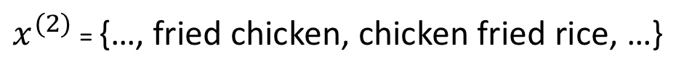
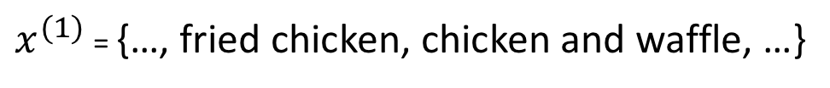
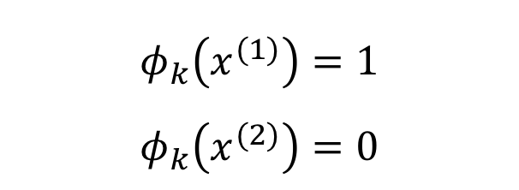
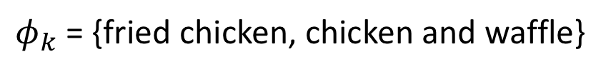
The wide model
cross-product transformation :
$φ_{k}$ = {fried chicken, chicken and waffle}
$$φ_{k}\left(x^{(1)}\right)=1$$
$$φ_{k}\left(x^{(2)}\right)=0$$
$x^{(1)}$ = {…, fried chicken, chicken and waffle, …}
$x^{(2)}$ = {…, fried chicken, chicken fried rice, …}

Slide 10
The deep model
Generalization
New feature combinations that have never or rarely occurre in the past

Slide 11
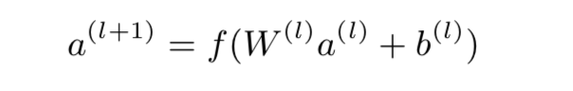
The deep model

Slide 12
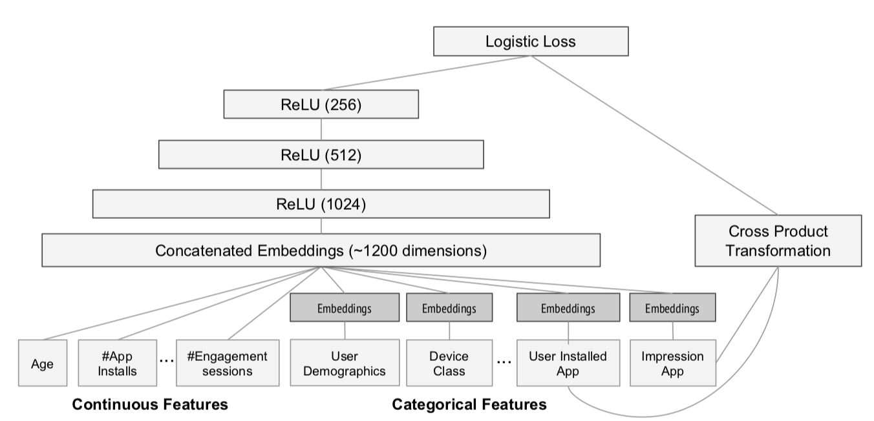
The wide & deep model

Slide 13
Continuous Features
Example feature name : "average_stars"
Example feature value : 3.63

Slide 14
Deep Categorical Features
Example feature name : "item_city"
Example feature value : ‘Phoenix’

Slide 15
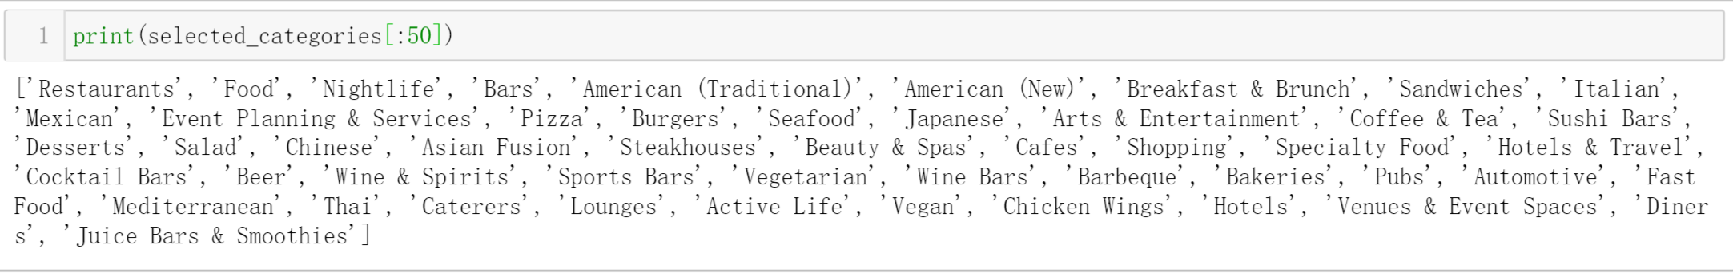
Wide Features

Slide 16
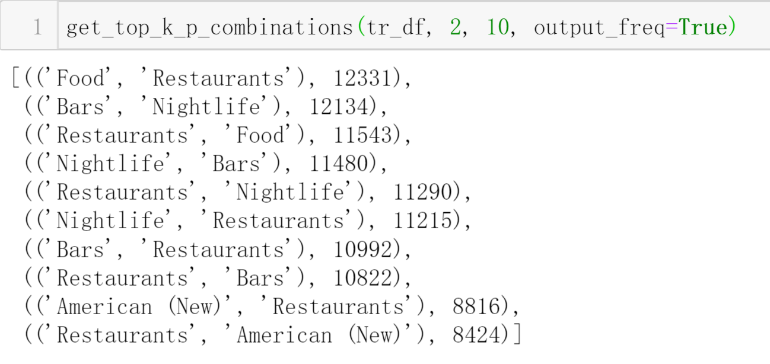
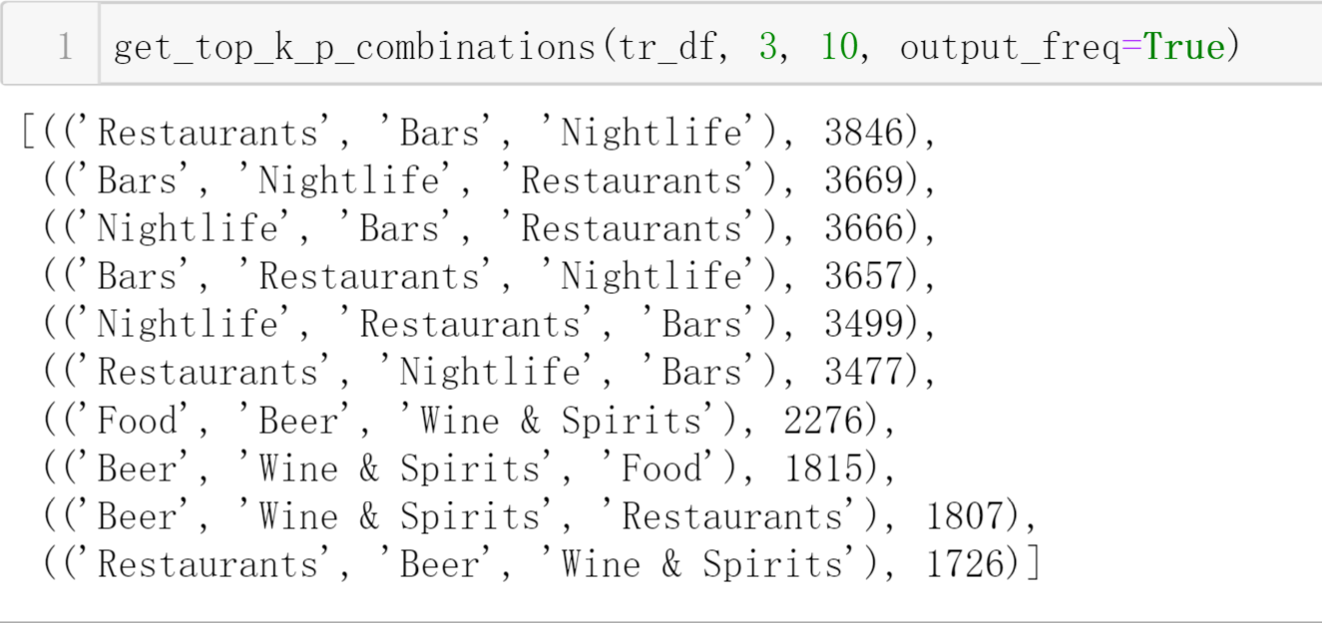
Wide Features

Slide 17
Wide & Deep for Rating Prediction
See the jupyter-notebook.

Slide 18
Thank You

